Slide 1
Machine Learning in Real World: C4.5

Slide 2
Zvezni atributi
Info _Before Split = info(7,7) = entropy(1/2,1/2) = 1
D | E | T | Class
X | 1 | 46 | a
Y | 3 | 65 | b
X | 2 | 68 | b
Y | 2 | 69 | b
X | 1 | 70 | b
Y | 3 | 71 | a
X | 2 | 72 | a
Y | 1 | 74 | a
X | 3 | 75 | a
Y | 3 | 75 | a
X | 1 | 80 | a
Y | 1 | 81 | b
X | 2 | 83 | b
y | 2 | 85 | b
InfoGain(D) = 0.02
InfoGain(E) = 0.05
InfoGain(T) = ???

Slide 3
InfoGain zveznega atributa
Velja enako kot za class-dependent diskretizacijo … delitev med primeri istega razreda ne more biti optimalna.
Delimo le med primeri različnih razredov.

Slide 4
46 | 65 | 68 | 69 | 70 | 71 | 72 | 74 | 75 | 75 | 80 | 81 | 83 | 85
a | b | b | b | b | a | a | a | a | a | a | b | b | b
55.5
70.5
80.5
IBS = 1
T | a | b | P(a) | P(b)
< 55.5 | 1 | 0 | 1 | 0
> 55.5 | 6 | 7 | 6/13 | 7/13
entropy(1,0) = 0
entropy(6/13,7/13) = - 6/13 * log(6/13) - 7/13 * log(7/13) = 0.996
T | Entropija | Frekvenca
< 55.5 | 0 | 1/14
> 55.5 | 0.996 | 13/14
Info(T, 55.5) = 0 * 1/14 + 0.996 * 13/14 = 0.925
InfoGain(T, 55.5) = 1 – 0.925 = 0.075
T | a | b | P(a) | P(b)
< 70.5 | 1 | 4 | 1/5 | 4/5
> 70.5 | 6 | 3 | 6/9 | 3/9
entropy(1/5,4/5) = - 1/5 * log(1/5) - 4/5 * log(4/5) = 0.722
entropy(6/9,3/9) = - 6/9 * log(6/9) - 3/9 * log(3/9) = 0.918
T | Entropija | Frekvenca
< 70.5 | 0.722 | 5/14
> 70.5 | 0.918 | 9/14
Info(T, 70.5) = 0.722 * 5/14 + 0.918 * 9/14 = 0.831
InfoGain(T, 70.5) = 1 – 0.831 = 0.169
T | a | b | P(a) | P(b)
< 80.5 | 7 | 4 | 7/11 | 4/11
> 80.5 | 0 | 3 | 0 | 1
entropy(7/11,4/11) = - 7/11 * log(7/11) - 4/11 * log(4/11) = 0.946
entropy(0,1) =0
T | Entropija | Frekvenca
< 80.5 | 0.946 | 11/14
> 80.5 | 0 | 3/14
Info(T, 80.5) = 0.946 * 11/14 + 0* 3/14 = 0.743
InfoGain(T, 80.5) = 1 – 0.743 = 0.257

Slide 5
InfoGain atributa T
Imamo tri InfoGain-e za vse tri možne delitve:
InfoGain(T, 55.5) = 0.075
InfoGain(T, 70.5) = 0.169
InfoGain(T, 80.5) = 0.257
Najboljša delitev je na 80.5
InfoGain atributa T je 0.257
Delimo po atributu T (InfoGain(D) = 0.02, InfoGain(E) = 0.05)
T
< 80.5
> 80.5
…
…

Slide 6
Manjkajoče vrednosti
Outlook | Temp | Humidity | Windy | Play
Sunny | Hot | High | False | No
Sunny | Hot | High | True | No
Overcast | Hot | High | False | Yes
Rainy | Mild | High | False | Yes
Rainy | Cool | Normal | False | Yes
Rainy | Cool | Normal | True | No
Overcast | Cool | Normal | True | Yes
Sunny | Mild | High | False | No
Sunny | Cool | Normal | False | Yes
Rainy | Mild | Normal | False | Yes
Sunny | Mild | Normal | True | Yes
? | Mild | High | True | Yes
Overcast | Hot | Normal | False | Yes
Rainy | Mild | High | True | No

Slide 7
V učni množici imamo N primerov
Atribute brez manjkajočih vrednosti obravnavamo nespremenjeno – upoštevamo vseh N primerov
Pri atributu A s k manjkajočimi vrednostmi:
Izračunamo InfoGain samo za n-k primerov (primeri kjer so vrednosti znane)
Dobljen InfoGain množimo z n-k/n

Slide 8
Gain(“outlook”)
IBS = Info([8,5]) = entropy(8/13,5/13) = -5/13 * log(5/13) – 8/13 * log(8/13) = 0.961
Outlook | Yes | No | P(yes) | P(no) | Entropy (bits) | Frekvenca
Sunny | 2 | 3 | 2/5 | 3/5
Overcast | 3 | 0 | 3/3 | 0/3
Rainy | 3 | 2 | 3/5 | 2/5
0.971
5/13
0
3/13
0.971
5/13
Entropy:
Sunny: Info([2,3]) = entropy(2/5,3/5) = -2/5 * log(2/5) – 3/5 * log(3/5) = 0.971
Overcast: Info([3,0]) = entropy(1,0) = -1 * log(1) – 0 * log(0) = 0
Rainy: Info([3,2]) = entropy(3/5,2/5) = -3/5 * log(3/5) – 2/5 * log(2/5) = 0.971
Info([2,3],[3,0],[3,2]) = 0.971 * (5/13) + 0 * (3/13) + 0.971 * (5/13) = 0.747
Gain(“outlook”) = 13/14 *( information before split – information after split)
Gain(“outlook”) = 13/14 * (0.961– 0.747) = 0.199

Slide 9
Information Gain:
Outlook: 0.199 bits
Temperature: 0.029 bits
Humidity: 0.152 bits
Wind: 0.048 bits

Slide 10
Outlook
Rainy
Sunny
Overcast
Outlook | Temp | Humidity | Windy | Play | Weight
Sunny | Hot | High | False | No | 1
Sunny | Hot | High | True | No | 1
Sunny | Mild | High | False | No | 1
Sunny | Cool | Normal | False | Yes | 1
Sunny | Mild | Normal | True | Yes | 1
? | Mild | High | True | Yes | 5/13
Outlook | Temp | Humidity | Windy | Play | Weight
Rainy | Mild | High | False | Yes | 1
Rainy | Cool | Normal | False | Yes | 1
Rainy | Cool | Normal | True | No | 1
Rainy | Mild | Normal | False | Yes | 1
Rainy | Mild | High | True | No | 1
? | Mild | High | True | Yes | 5/13
Outlook | Temp | Humidity | Windy | Play | Weight
Overcast | Hot | High | False | Yes | 1
Overcast | Cool | Normal | True | Yes | 1
Overcast | Hot | Normal | False | Yes | 1
? | Mild | High | True | Yes | 3/13

Slide 11
Nadaljujemo v veji Outlook=Sunny
Outlook | Temp | Humidity | Windy | Play | Weight
Sunny | Hot | High | False | No | 1
Sunny | Hot | High | True | No | 1
Sunny | Mild | High | False | No | 1
Sunny | Cool | Normal | False | Yes | 1
Sunny | Mild | Normal | True | Yes | 1
? | Mild | High | True | Yes | 5/13 ~ 0.4
IBS = Info(3, 2.4) = entropy(0.56,0.44) = -0.56*log(0.56)-0.44*log(0.44) = 0.99
Hum. | Yes | No | P(yes) | P(no) | Entropy (bits) | Frekvenca
High | 0.4 | 3 | 0.4/3.4 = 0.118 | 3/3.4 = 0.882 | 0.524 | 3.4 / 5.4 = 0.63
Normal | 2 | 0 | 2/2 = 1 | 0/2 = 0 | 0 | 2 / 5.4 = 0.37
High: info([0.4,3]) = entropy(0.118, 0.882) = -0.118*log(0.118)-0.882*log(0.882) = 0.524
Normal: info([2,0]) = entropy(1,0) = 0
Info([0.4,3],[2,0]) = 0.524*0.63 + 0*0.37 = 0.33
Gain(“Humidity”) = info([2,3]) - Info([0,3],[2,0]) = 0.99 – 0.33 = 0.66

Slide 12
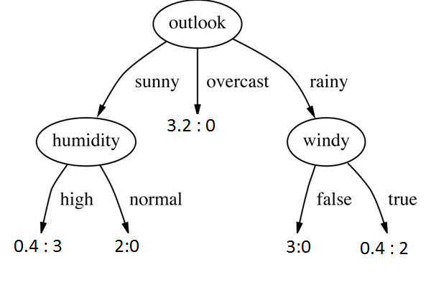
Yes (100%)
No(88%)
Yes(100%)
Yes(100%)
No(cca. 80%)

Slide 13
Klasifikacija primerov z neznanimi vrednostmi
Razporeditev razredov v listih:
4:3 pomeni:
4 primeri z razredom yes 3 primeri z razredom no
?
Outlook | Temp | Humidity | Windy | Play
Sunny | Cool | ? | False
No
P(YES) = 3.4/5.4 * 12% + 2/5.4 * 100% = 44%
P(NO) = 3.4/5.4 * 88% + 2/5.4 * 0% = 56%
Outlook | Temp | Humidity | Windy | Play
? | Cool | ? | False
P(YES) = 5.4/14 * (3.4/5.4 * 0.4/3.4 + 2/5.4 * 2/2) + 3.2/14 * 3.2/3.2 + 5.4/14 * (3/3) = 79%
P(NO) = 5.4/14 * (3.4/5.4 * 3/3.4 + 2/5.4 * 0/2) + 3.2/14 * 0/3.2 + 5.4/14 * (0/3) = 21%

Slide 14
Šum – robustnost
Prekomerno prileganje (overfitting) preprečimo z rezanjem dreves
Dve možnosti rezanja dreves:
Naknadno rezanje (post-pruning): iz dokončanega drevesa odstranimo nezanesljive veje
Predhodno rezanje (pre-pruning): ustavimo “rast” drevesa ko postane informacija nezanesljiva
V praksi je boljši post-pruning, pre-pruning se lahko ustavi prehitro

Slide 15
Rezanje (+/-)
Pre-pruning je bistveno hitrejši
Ne zgradimo celotnega drevesa, prej nehamo
Post-pruning zgradi celo drevo in potem še reže
Pre-pruning delovanje:
Minimalno število primerov v listu (če je manj ne delimo)
Minimalno število primerov v vozlišču
Kriterij zastopanosti večinskega razreda (> 95% itd.)
globina

Slide 16
Naknadno rezanje
Zgradimo celo drevo in potem režemo
Dve operaciji:
Menjava poddreves
Dvig poddreves
Tri možne strategije:
Ocena napake
Test značilnosti
MDL princip

Slide 17
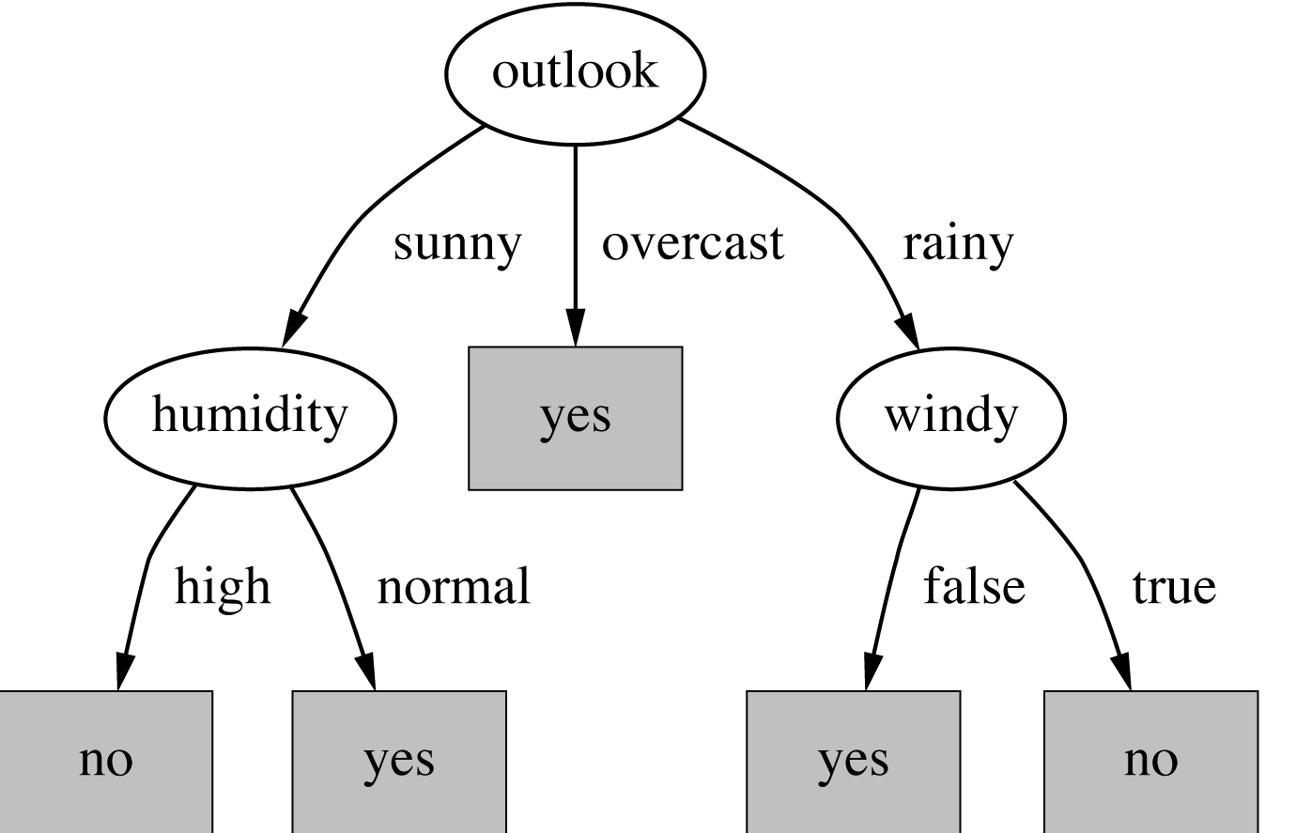
Izpeljava pravil iz dreves
Vsak list eno pravilo

